Slide 1
Exploratory analysis and Time Series Regression
Lecture 2

Slide 2

Recap
Time series
White noise
Random walk
Moving average filter
Autocovariance and autocorrelation functions:
$$γ_{x}\left(s,t\right)=cov\left(x_{s},x_{t}\right)=E\left[(x_{s}−μ_{s})(x_{t}−μ_{t})\right]$$
$$ρ\left(s,t\right)=\frac{γ\left(s,t\right)}{\sqrt{γ\left(s,s\right)γ\left(t,t\right)}}$$

Slide 3
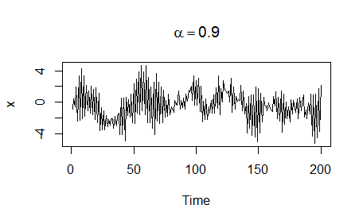
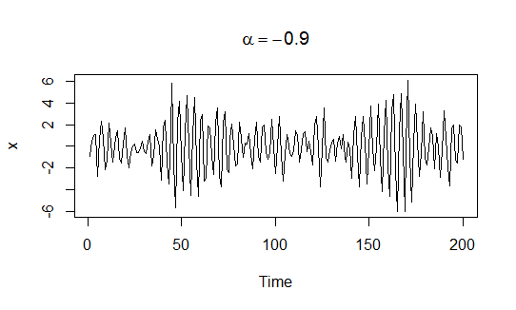

Autocovariance
Intuition:
$x_{t}=αx_{t−1}+w_{t}→cov\left(x_{t},x_{t−1}\right)=α$

Slide 4
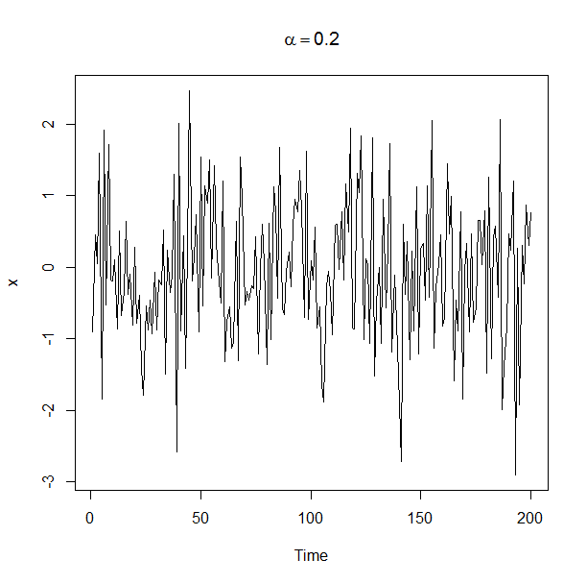
Autocovariance

Slide 5
Stationarity
We found: sometimes $γ\left(s,t\right)$ depends on lag $\left|s−t\right|$ only
Time series is strictly stationary if distributions of $\{x_{t_{1}},…x_{t_{n}}\}$ and $\{x_{t_{1}+h},…x_{t_{n}+h}\}$ are identical for any $t_{1},…t_{n}$ and all lags $h=0, ±1,±2,..$
$$P\left(x_{t_{1}}≤c_{1}, …x_{t_{n}}≤c_{n}\right)=P\left(x_{t_{1}+h}≤c_{1}, …x_{t_{n}+h}≤c_{n}\right)$$
Note: This means $Ex_{t}=const$, $cov\left(x_{t}, x_{t+h}\right)=const$
Interpretation: Time series behave similarly with time (underlying generating process is the same)

Slide 6
Stationarity
Strong stationarity is often too strong
Time series $x_{t}$ is weakly stationary (stationary) if
$Ex_{t}=const$
$γ_{x}\left(s,t\right)=γ(\left|s−t\right|)$
$var\left(x_{t}\right)<∞$
$γ_{x}\left(t,t+h\right)=γ\left(\left|t+h−t\right|\right)=γ(h)$
Autocovariance depends on lag only!
Autocovariance for stationary process $γ\left(h\right)=cov\left(x_{t},x_{t+h}\right)$
ACF for stationary process $ρ\left(h\right)=\frac{γ\left(h\right)}{γ\left(0\right)}$

Slide 7
Stationarity
Properties of stationary process:
$$γ\left(h\right)=γ\left(−h\right), ρ\left(h\right)=ρ(−h)$$
$$\left|γ\left(h\right)\right|≤γ\left(0\right), \left|ρ\left(h\right)\right|≤1$$
$$ρ\left(0\right)=1$$
Are those stationary?
White noise
Moving average $x_{t}=0.5w_{t}+0.2w_{t−1}+0.2w_{t+1}$
Random walk $x_{t}=δt+\sum_{j=1}^{t}{w_{j}}$

Slide 8
Linear process
$x_{t}$ is a linear process if
$$x_{t}=μ+\sum_{j=−∞}^{∞}{ψ_{j}w_{t−j}}$$
It can be shown
$$γ_{x}(h)=σ_{w}^{2}\sum_{j=−∞}^{∞}{ψ_{j+h}ψ_{j}}$$
Recall moving average example…

Slide 9
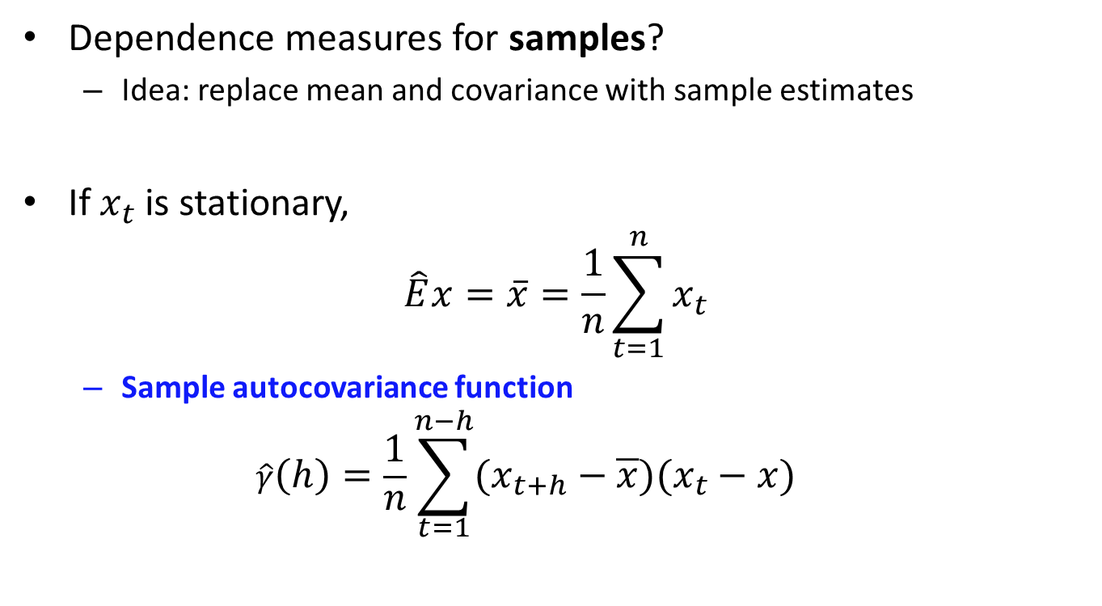
Sample autocovariance and ACF
Dependence measures for samples?
Idea: replace mean and covariance with sample estimates
If $x_{t}$ is stationary,
$$\hat{E}x=\overline{x}=\frac{1}{n}\sum_{t=1}^{n}{x_{t}}$$
Sample autocovariance function
$$\hat{γ}\left(h\right)=\frac{1}{n}\sum_{t=1}^{n−h}{(x_{t+h}−\overline{x})(x_{t}−x)}$$

Slide 10
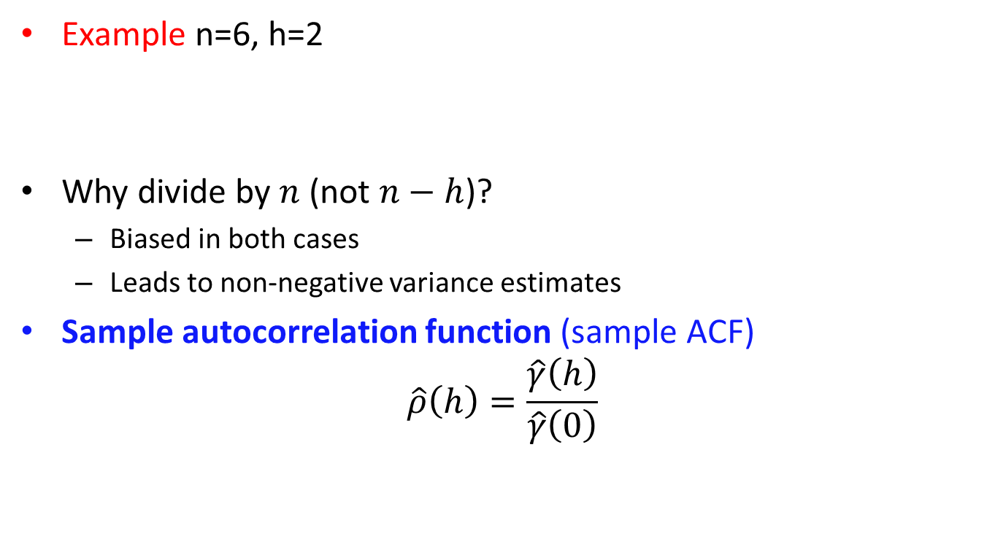
Sample autocovariance and ACF
Example n=6, h=2
Why divide by $n$ (not $n−h$)?
Biased in both cases
Leads to non-negative variance estimates
Sample autocorrelation function (sample ACF)
$$\hat{ρ}\left(h\right)=\frac{\hat{γ}\left(h\right)}{\hat{γ}\left(0\right)}$$
 |  | 1 | 2 | 3 | 4 | 5 | 6
1 | 2 | 3 | 4 | 5 | 6

Slide 11
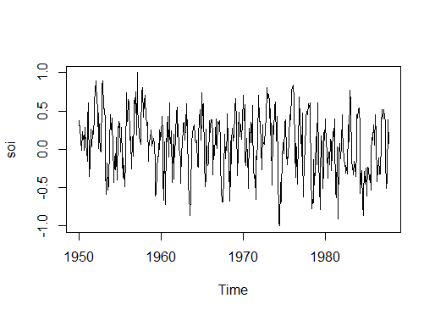
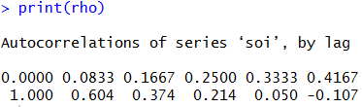
Sample ACF
In R: acf()
Example: southern oscillation index (SOI)
rho=acf(soi, 5, type="correlation", plot=T)
Why sample ACF is ‘1’ for h=0?

Slide 12
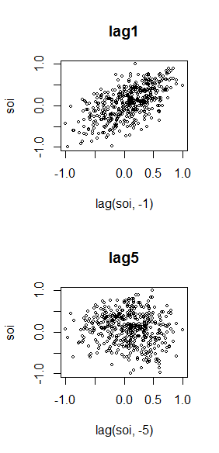
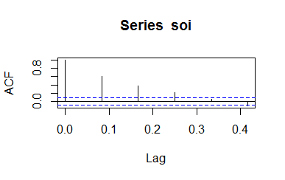
Sample ACF

Slide 13
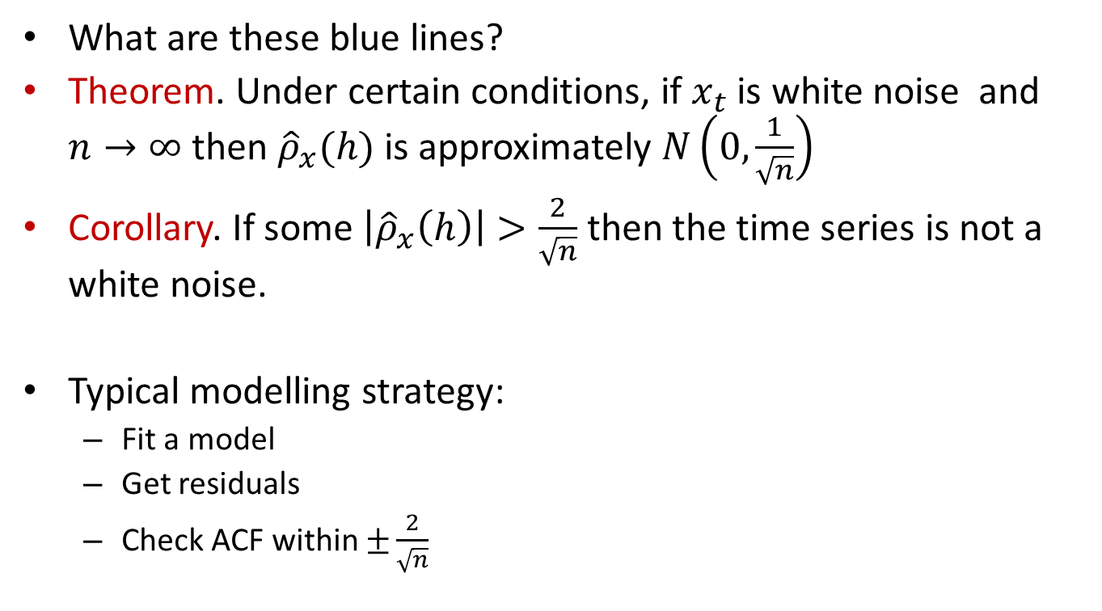
Sample ACF
What are these blue lines?
Theorem. Under certain conditions, if $x_{t}$ is white noise and $n→∞$ then ${\hat{ρ}}_{x}(h)$ is approximately $N\left(0,\frac{1}{\sqrt{n}}\right)$
Corollary. If some $\left|{\hat{ρ}}_{x}\left(h\right)\right|>\frac{2}{\sqrt{n}}$ then the time series is not a white noise.
Typical modelling strategy:
Fit a model
Get residuals
Check ACF within $±\frac{2}{\sqrt{n}}$

Slide 14



Sample ACF vs theoretical
Moving averages $x_{t}=0.5w_{t}+0.2w_{t−1}+0.2w_{t+1}$
ACF $γ\left(h\right)≈\left\{\begin{aligned}1,h=0 \\ 0.61, h=1 \\ 0.12, h=2 \\ 0. other\end{aligned}\right.$
$n=10$
$n=1000$

Slide 15
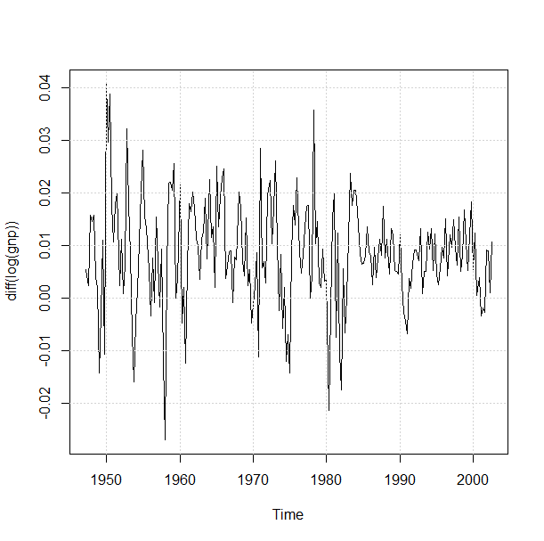

Recap: time domain modeling
Time Series data
$$Y_{t}=∇\left(\log\left(X_{t}\right)\right)$$
Exploratory data analysis
Make data stationary

Slide 16
Stationarity
Why do we need stationarity?
Sample ACF becomes consistent
ARIMA models require stationarity
Tools
Detrending (trend removal)
Differencing
Transformations

Slide 17
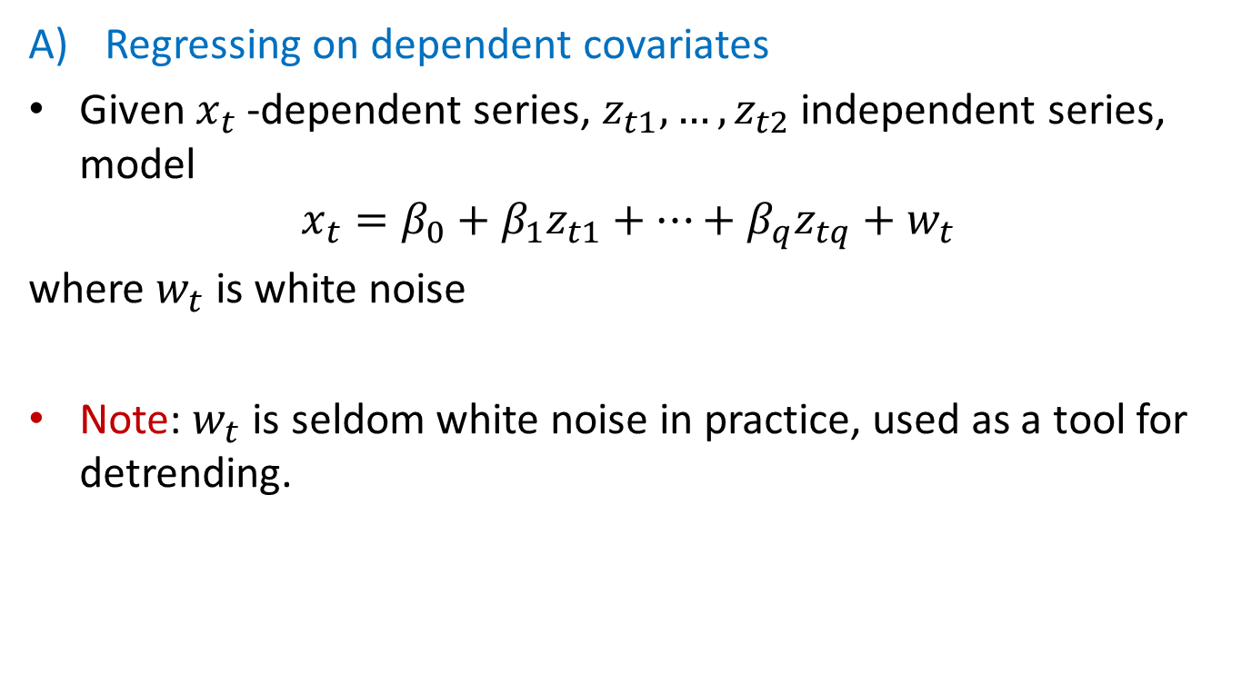
Trend removal
Regressing on dependent covariates
Given $x_{t}$ -dependent series, $z_{t1},…,z_{t2}$ independent series, model
$$x_{t}=β_{0}+β_{1}z_{t1}+…+β_{q}z_{tq}+w_{t}$$
where $w_{t}$ is white noise
Note: $w_{t}$ is seldom white noise in practice, used as a tool for detrending.

Slide 18
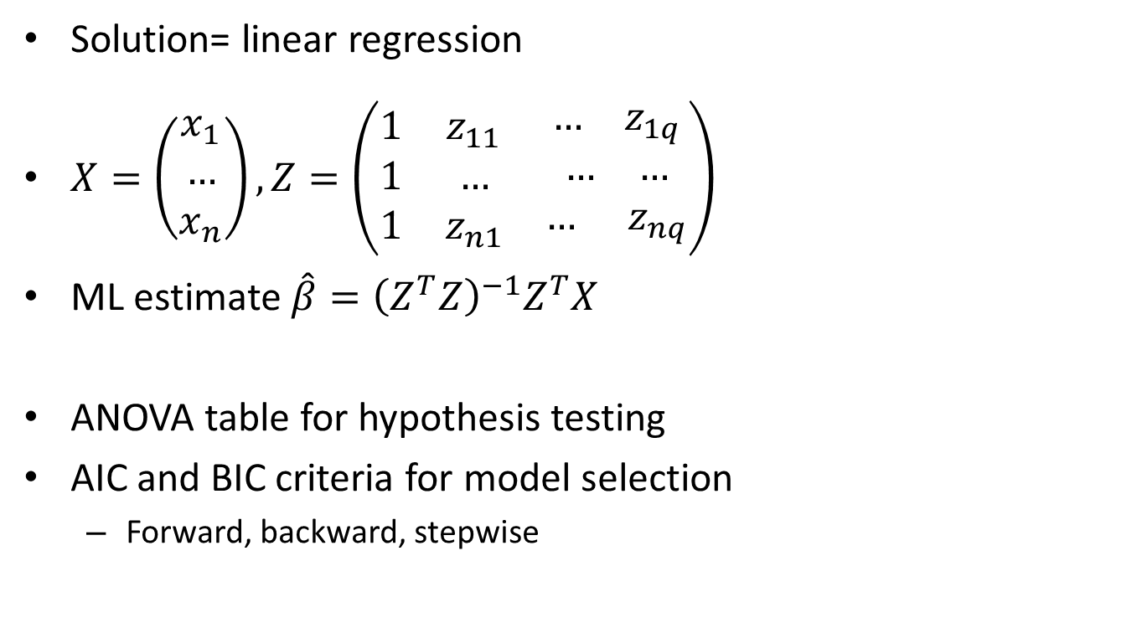
Trend removal
Solution= linear regression
$X=\left(\begin{aligned}x_{1} \\ … \\ x_{n}\end{aligned}\right), Z=\left(\begin{matrix}1 & z_{11} & \begin{matrix}… & z_{1q}\end{matrix} \\ 1 & … & \begin{matrix}… & …\end{matrix} \\ 1 & z_{n1} & \begin{matrix}… & z_{nq}\end{matrix}\end{matrix}\right)$
ML estimate $\hat{β}={\left(Z^{T}Z\right)}^{−1}Z^{T}X$
ANOVA table for hypothesis testing
AIC and BIC criteria for model selection
Forward, backward, stepwise

Slide 19
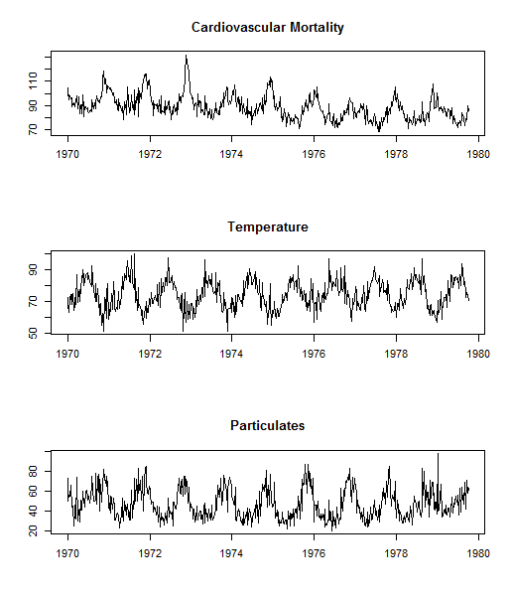
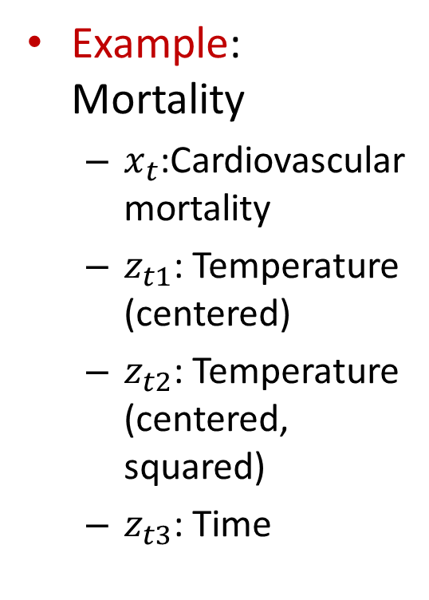
Trend removal
Example: Mortality
$x_{t}$:Cardiovascular mortality
$z_{t1}$: Temperature (centered)
$z_{t2}$: Temperature (centered, squared)
$z_{t3}$: Time
Relationship between series

Slide 20
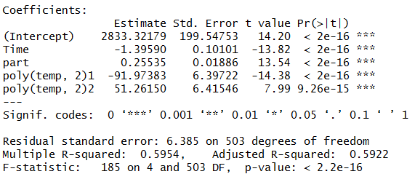
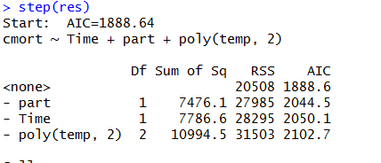

Trend removal

Slide 21
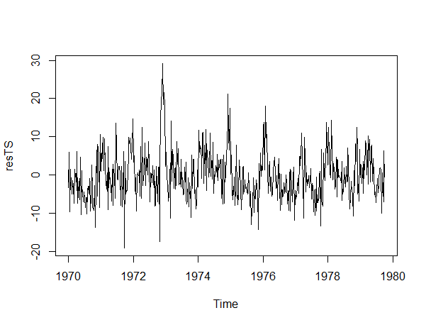
Trend removal
Residuals
Stationary?
Independent?
Some additional modeling of the residuals (ARIMA) can be done

Slide 22
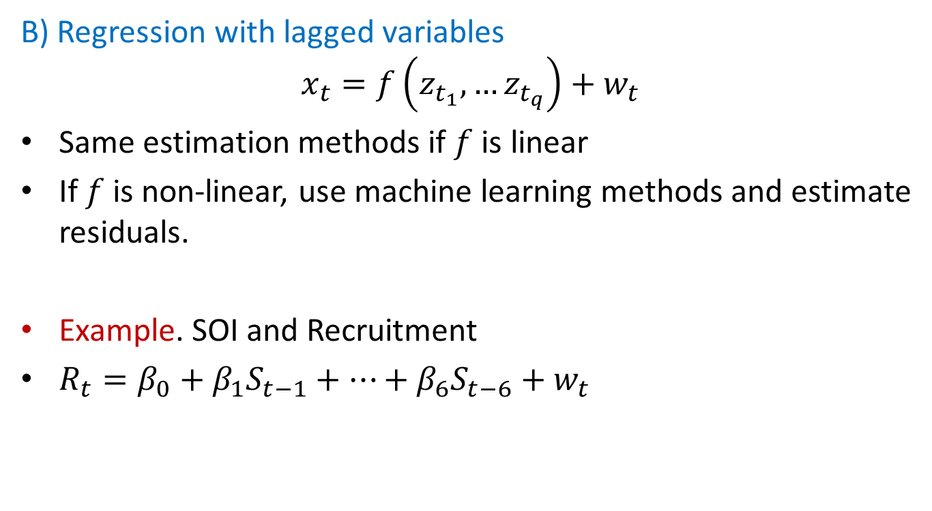
Trend removal
B) Regression with lagged variables
$$x_{t}=f\left(z_{t_{1}},…z_{t_{q}}\right)+w_{t}$$
Same estimation methods if $f$ is linear
If $f$ is non-linear, use machine learning methods and estimate residuals.
Example. SOI and Recruitment
$R_{t}=β_{0}+β_{1}S_{t−1}+…+β_{6}S_{t−6}+w_{t}$

Slide 23
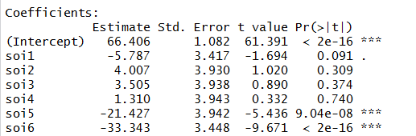
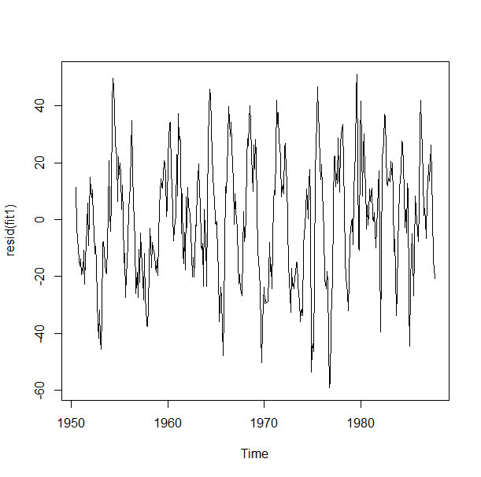
Trend removal

Slide 24
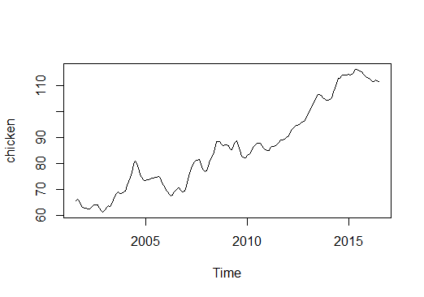
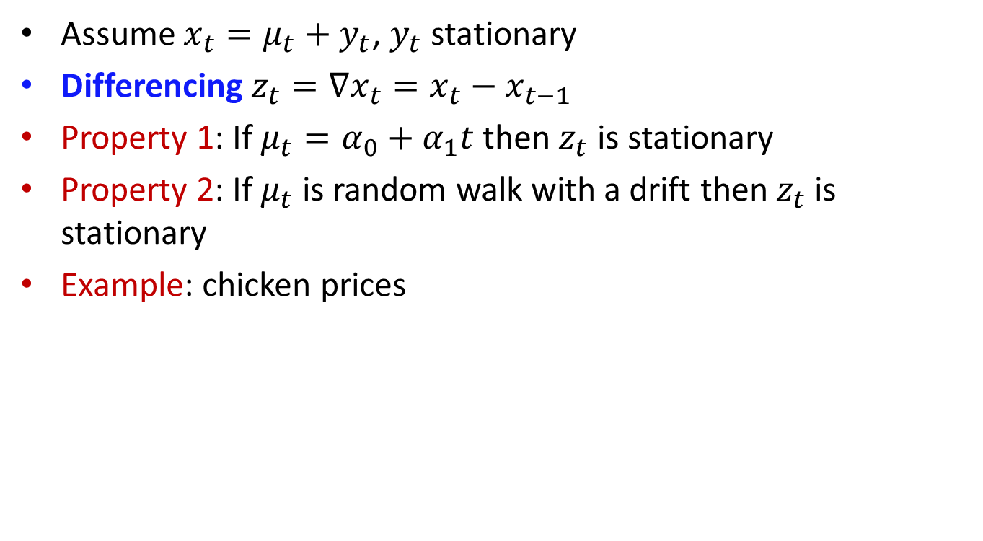
Differencing
Assume $x_{t}=μ_{t}+y_{t}$, $y_{t}$ stationary
Differencing $z_{t}=∇x_{t}=x_{t}−x_{t−1}$
Property 1: If $μ_{t}=α_{0}+α_{1}t$ then $z_{t}$ is stationary
Property 2: If $μ_{t}$ is random walk with a drift then $z_{t}$ is stationary
Example: chicken prices

Slide 25
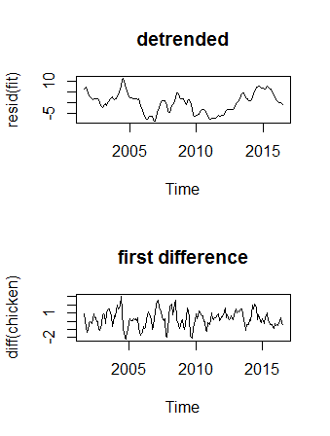
Differencing
Which looks more random? Other differences?

Slide 26
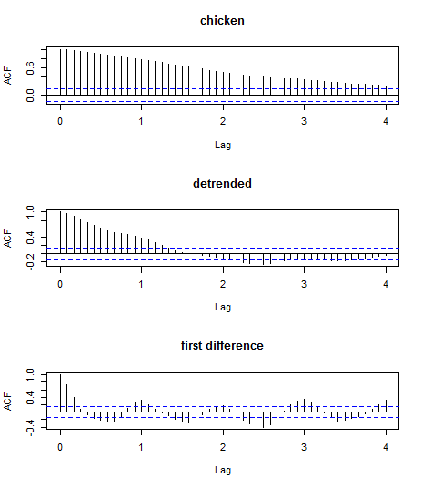
Differencing

Slide 27
Detrending vs differencing
Differencing is more flexible vs linear detrending
Differencing does not require model estimation
If trend is complex, detrending with a complex ML model can be better
Differencing does not gives us the trend

Slide 28
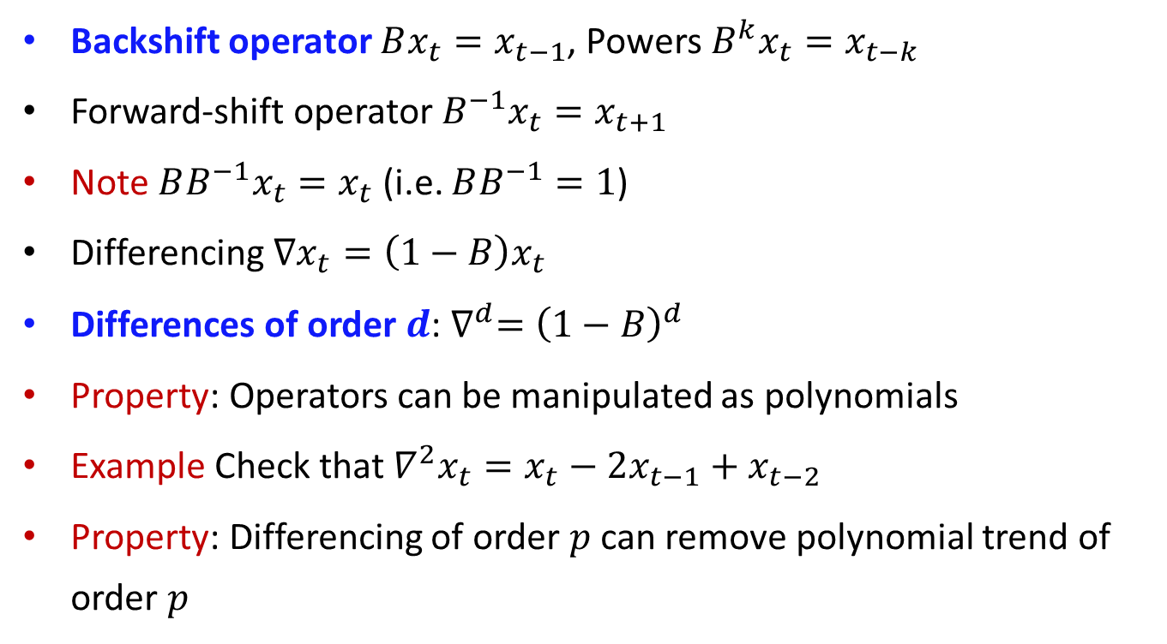
Backshift operator
Backshift operator $Bx_{t}=x_{t−1}$, Powers $B^{k}x_{t}=x_{t−k}$
Forward-shift operator $B^{−1}x_{t}=x_{t+1}$
Note $BB^{−1}x_{t}=x_{t}$ (i.e. $BB^{−1}=1$)
Differencing $∇x_{t}=\left(1−B\right)x_{t}$
Differences of order $d$: $∇^{d}={\left(1−B\right)}^{d}$
Property: Operators can be manipulated as polynomials
Example Check that $∇^{2}x_{t}=x_{t}−2x_{t−1}+x_{t−2}$
Property: Differencing of order $p$ can remove polynomial trend of order $p$

Slide 29
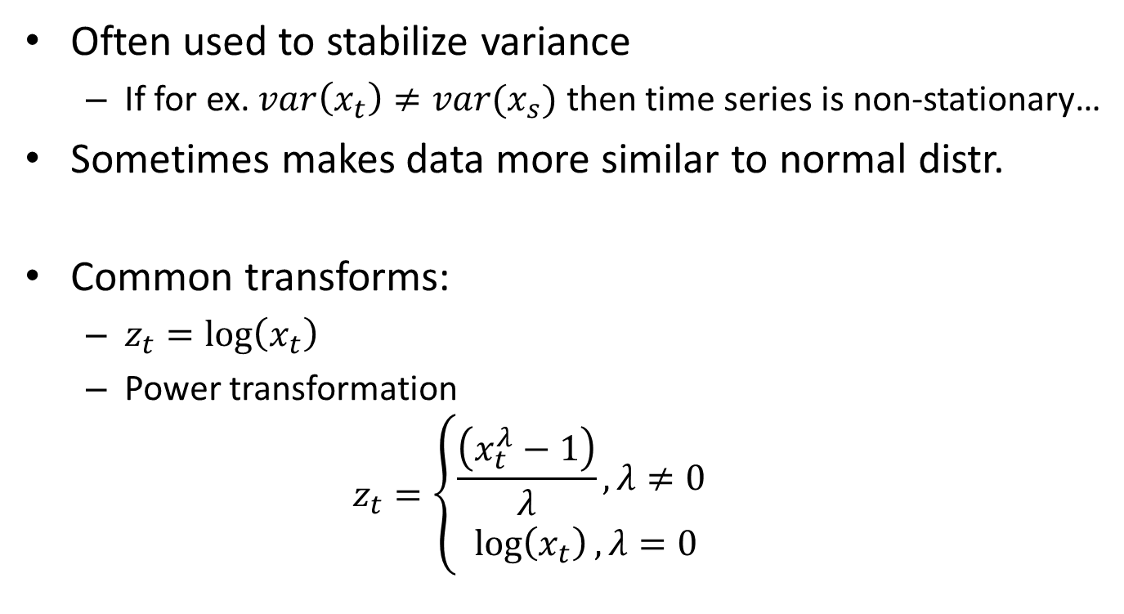
Transformations
Often used to stabilize variance
If for ex. $var\left(x_{t}\right)≠var(x_{s})$ then time series is non-stationary…
Sometimes makes data more similar to normal distr.
Common transforms:
$z_{t}=\log\left(x_{t}\right)$
Power transformation
$$z_{t}=\left\{\begin{matrix}\frac{\left(x_{t}^{λ}−1\right)}{λ},λ≠0 \\ \log\left(x_{t}\right), λ=0\end{matrix}\right.$$

Slide 30
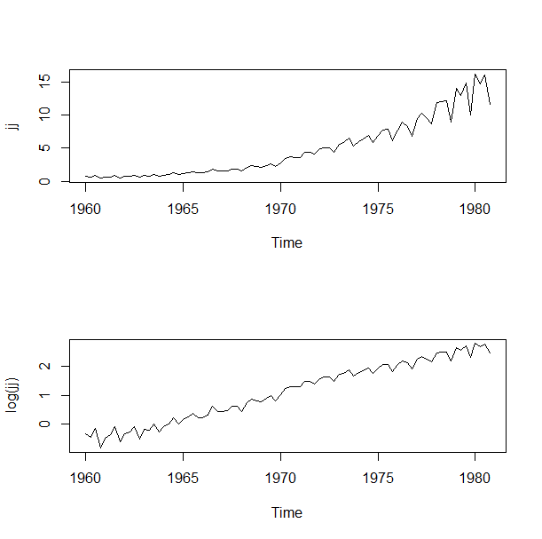
Transformations
Johnson & Johnson quarterly earnings

Slide 31
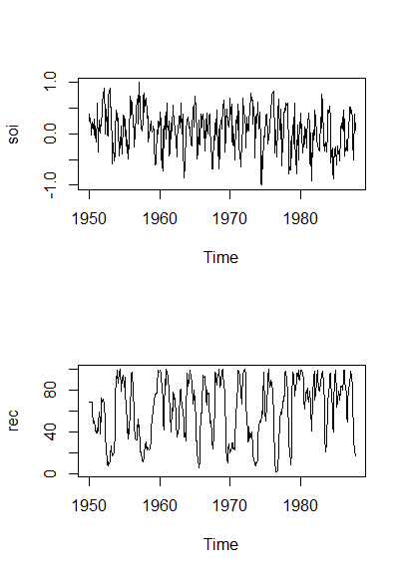
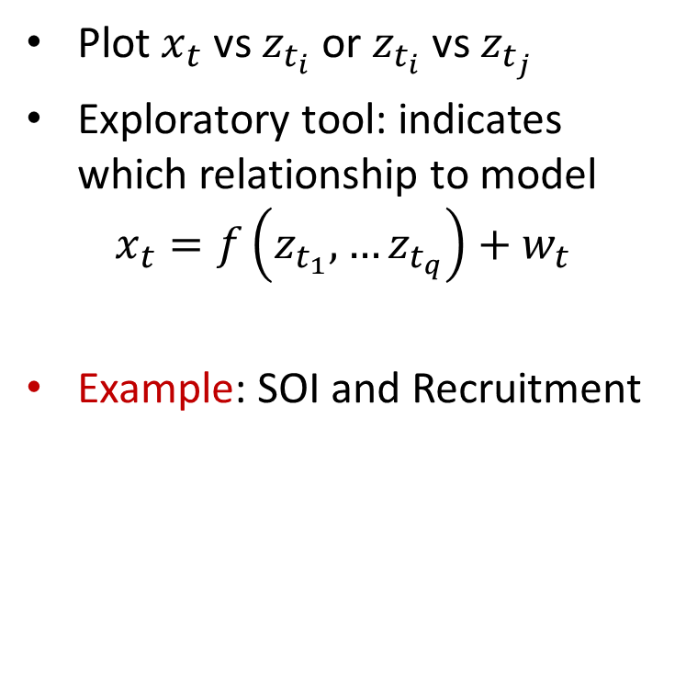
Scatterplots
Plot $x_{t}$ vs $z_{t_{i}}$ or $z_{t_{i}}$ vs $z_{t_{j}}$
Exploratory tool: indicates which relationship to model
$$x_{t}=f\left(z_{t_{1}},…z_{t_{q}}\right)+w_{t}$$
Example: SOI and Recruitment

Slide 32
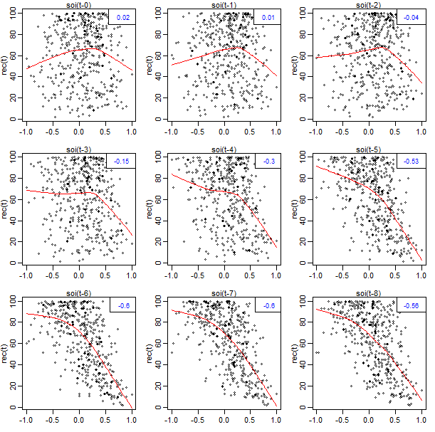
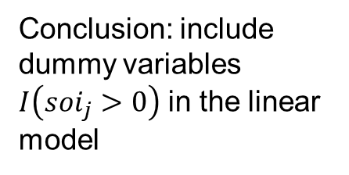
Scatterplots
Which relationships are nonlinear?
Conclusion: include dummy variables $I\left(soi_{j}>0\right)$ in the linear model

Slide 33
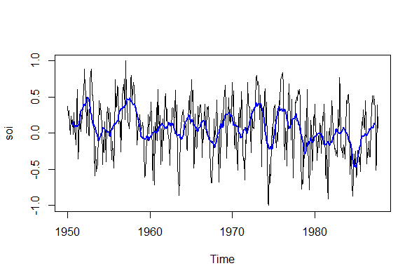
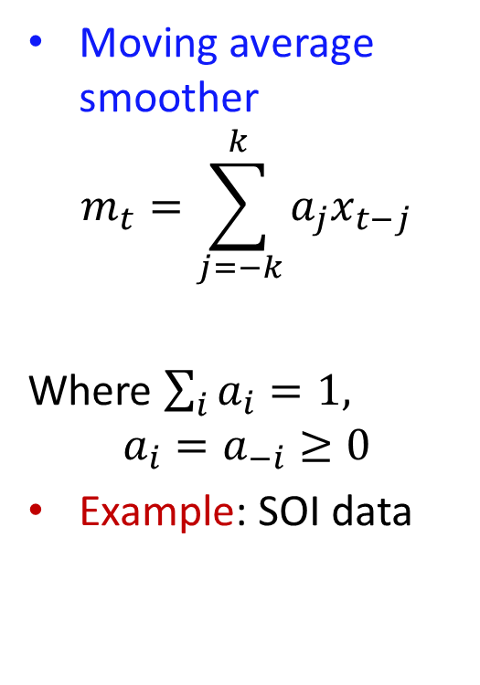
Other detrending models
Moving average smoother
$$m_{t}=\sum_{j=−k}^{k}{a_{j}x_{t−j}}$$
Where $\sum_{i}{a_{i}}=1,$
$$a_{i}=a_{−i}≥0$$
Example: SOI data
Disadvantage?

Slide 34
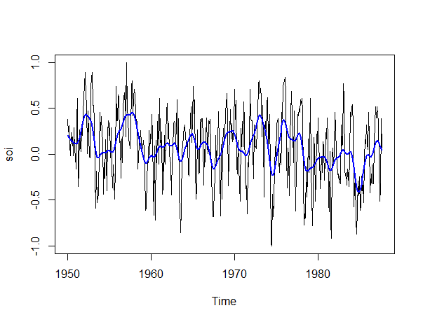
Other detrending models
Better models? Welcome to ML courses!
Splines
Kernel smoothers
Gaussian Process
Neural networks
…
Example: kernel smoothers

Slide 35
Home reading
SS, ch. 1.5, ch.2
TS functions: lag, ksmooth, lm, diff, lag1.plot, lag2.plot

